Slide 1
PROCESS MONITORING & CONTROL

Slide 2
Planning for a New Tomorrow
Joshua Mellen
Product Manager
Bhawuk Luthra
Engineering Consultant
Dominion Energy

Slide 3


Bhawuk Luthra, Engineering Consultant Josh Mellen, Product Manager
Planning for a New Tomorrow
― Forecast-Driven Outage Planning for System Operations Center ―
Notes:
Title: Planning for a New Tomorrow – Forecast-Driven Outage Planning for System Operations Center
Abstract: Dominion Energy is facing considerable growth across its operating territory – much of it stemming from non-conforming load produced by technology and the EV sector. The need for improved forecasting is becoming a mandatory part of our operations and company decision making in outage planning. In this session, we will discuss strategies and tactics around long-term load forecasts (LTLF) for area, substation and transformer-level forecasting, including the development of an operating framework utilizing Seeq. We will also explore real world case studies on managing and reprioritizing outages, thus enhancing system reliability and operational efficiency.

Slide 4

Dominion Energy at a Glance
DRIVEN BY OUR RELIABILITY OBJECTIVES
Who we are. Where we reside. What we do.
We are a leading energy company providing clean, safe, and reliable energy to >3.5M customers across the US
Our team is within the Transmission part of the organization, where we own and support applications such as PI, Seeq, Predictive Grid.
We added Seeq to our tech stack in 2023 to help empower our users with low code, no code option for data analytics
Generation
Transmission
Distribution
Customer

Slide 5
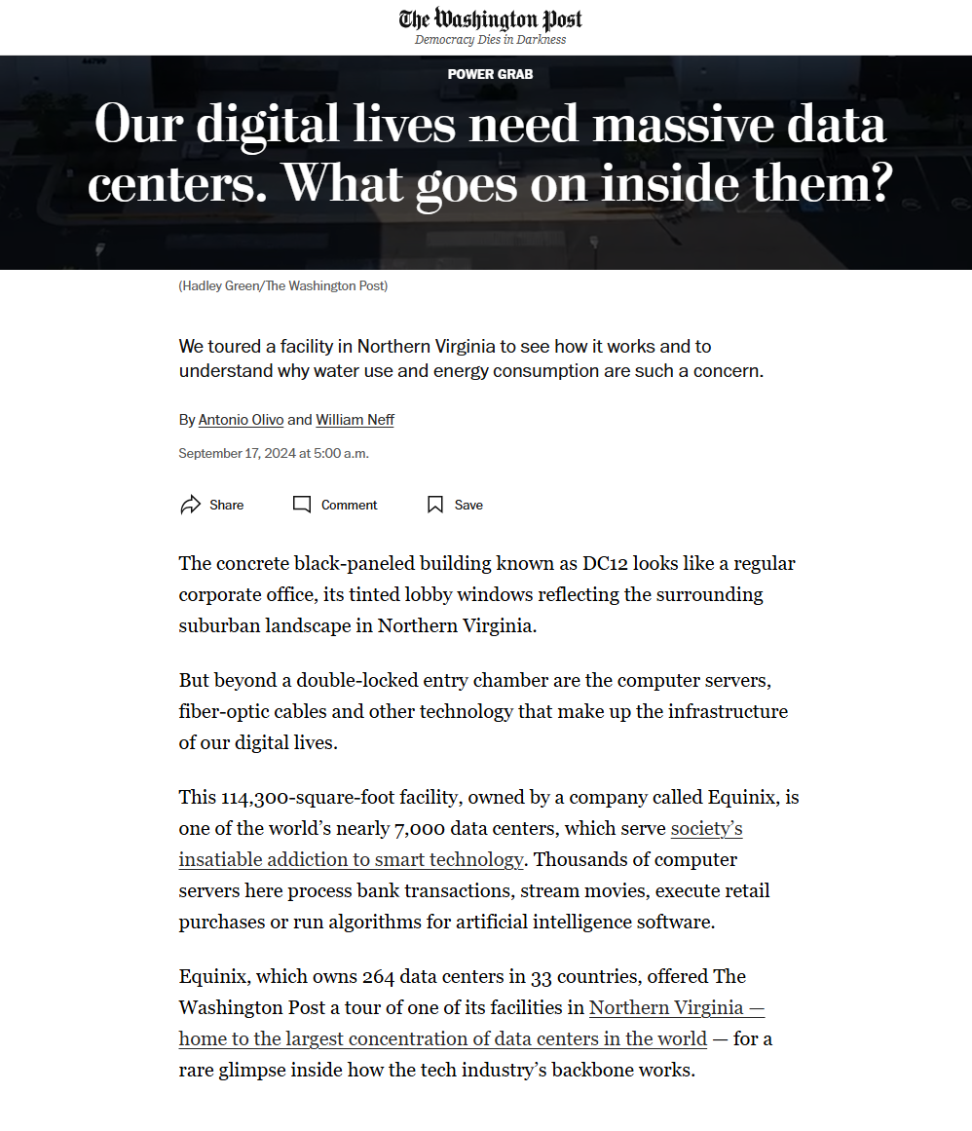
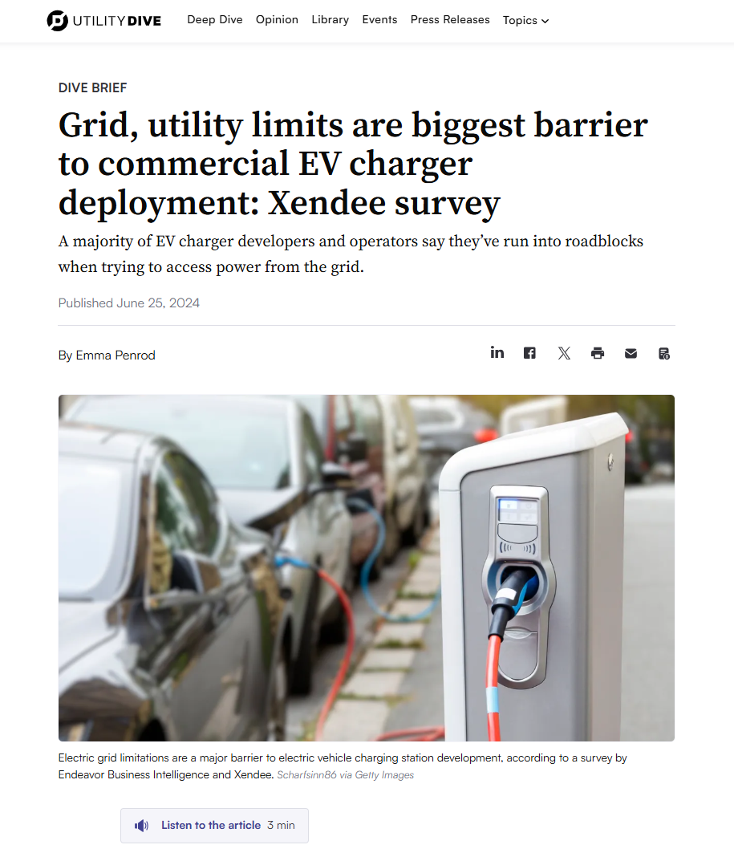
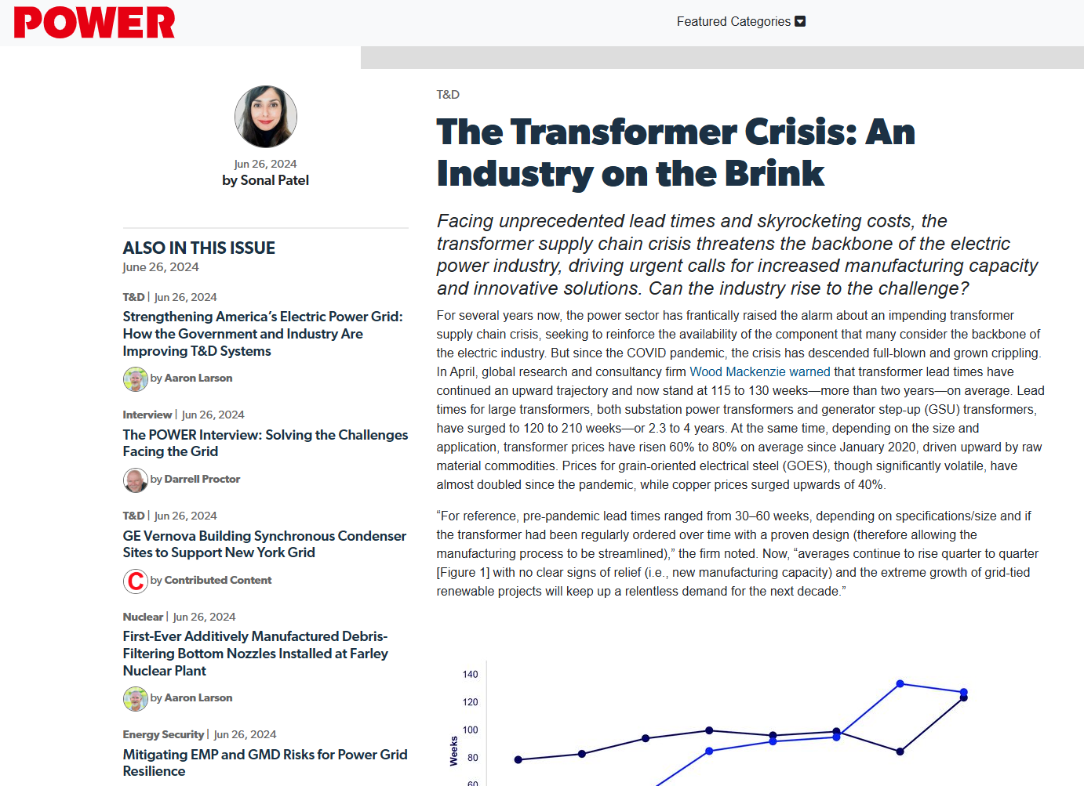
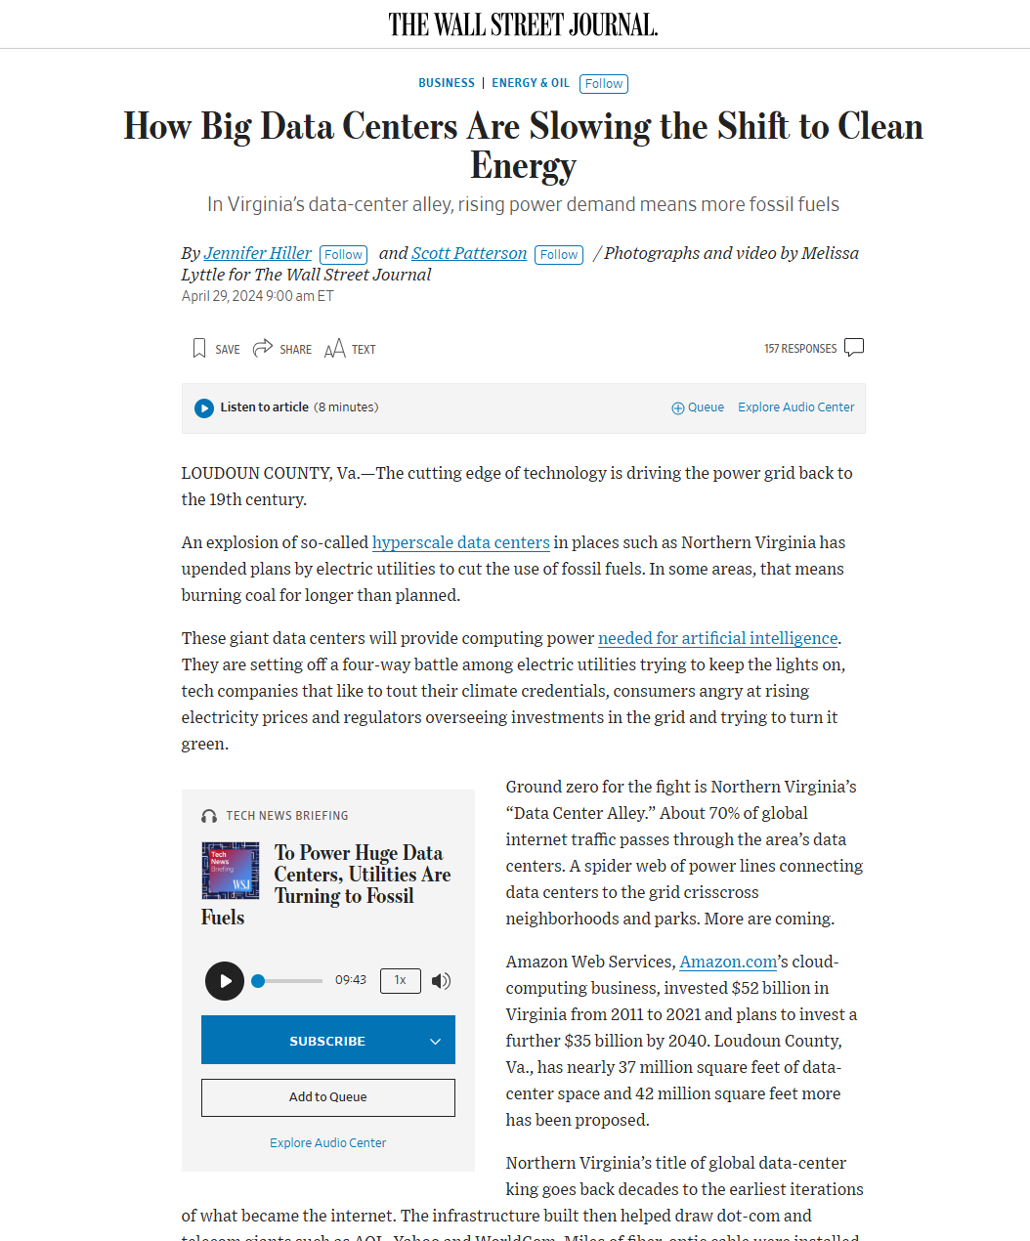
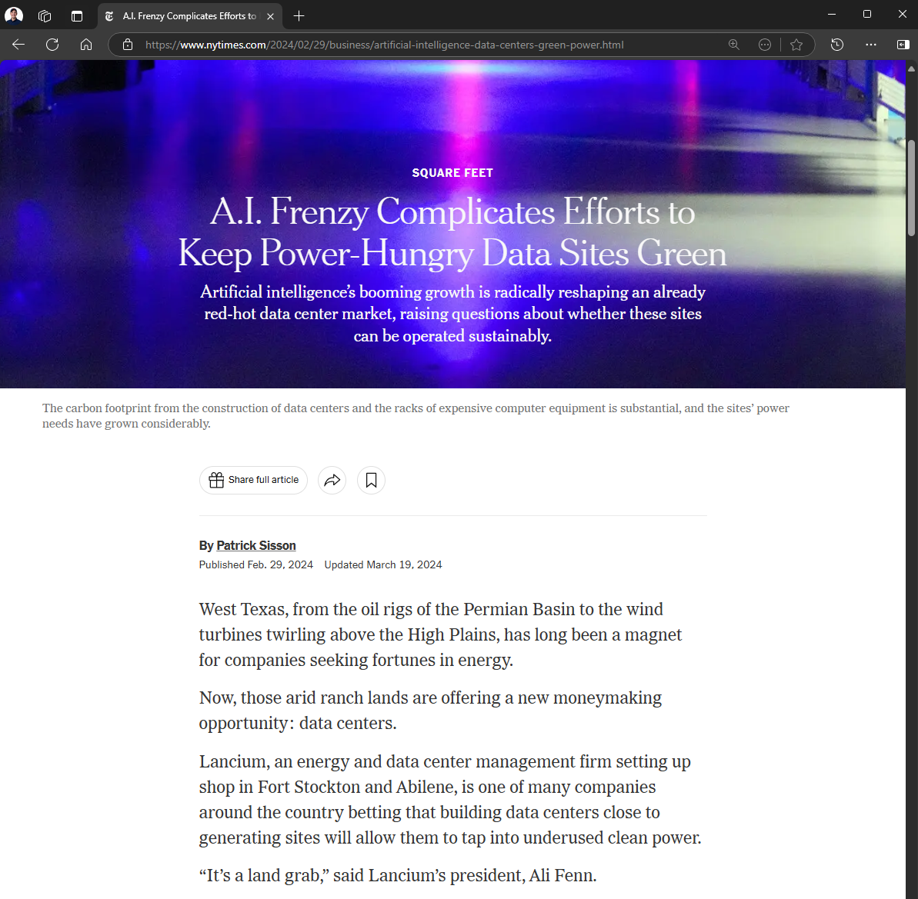
An Evolving and Present Challenge
CHALLENGES DOMINION ENERGY IS FACING
And it’s Newsworthy
Transmission operators across the country are facing the impact of a power-hungry commercial sector.
From the demand side, streaming, artificial intelligence, and commercial EVs are creating influxes of power usage.
Unprecedented growth means unprecedented demand on infrastructure development. Keeping up with demand will require an overhaul of supply chain manufacturing to project deployment all while keeping our rate bases in check.

Slide 6
The Importance of Transmission Forecasting
ENTER FORECASTING
“short term”
“long term”
Sales and Revenue
Not All Forecasts are Built the Same. Nor Should They.
Time horizons, service areas, and business objectives can vary.
Transmission can no longer rely on an overengineered grid.
Our Focus for Transmission Today
We’re hyper-focused on our SOC objectives.
We forecast three areas. Over 100 substations. Over 300 transformers.
We’re capturing data from nearly a dozen sources – a complex business challenge in a conventionally siloed organization.
An emphasis on transparency & explainability (non-blackbox).
Integration with our modeling systems including EMS & ANODE
Constrained Zone
RTO Projections
Outage Planning
Bus-level
Area Forecast
Capital Investment Planning
1 Year
15 Year IRP
Business Intelligence

Slide 7
This is Our Transmission Forecast Story
OUR FOUR PART STORY
From Framework to Business Impact
Our Business Objectives
Building a Sustainable Framework
Visualization: The Importance of Data Storytelling
Our Business Objectives
Enabling Dominion: Applied Forecast Case Studies

Slide 8
FORECASTING FRAMEWORK
Data Collection
and
Processing
Exploratory
Data Analysis:
Identify Patterns
and
Data Cleansing
Feature
Engineering:
Regressor
and
Scenario
Evaluation
Model Selection:
Explore and
Train Models,
Test Forecast,
Tune Model
Develop
and
Reconcile
Forecast
Feedback:
Deliver Results,
Gather Feedback,
Iterate
Continuous Improvement/Continuous Deployment

Slide 9
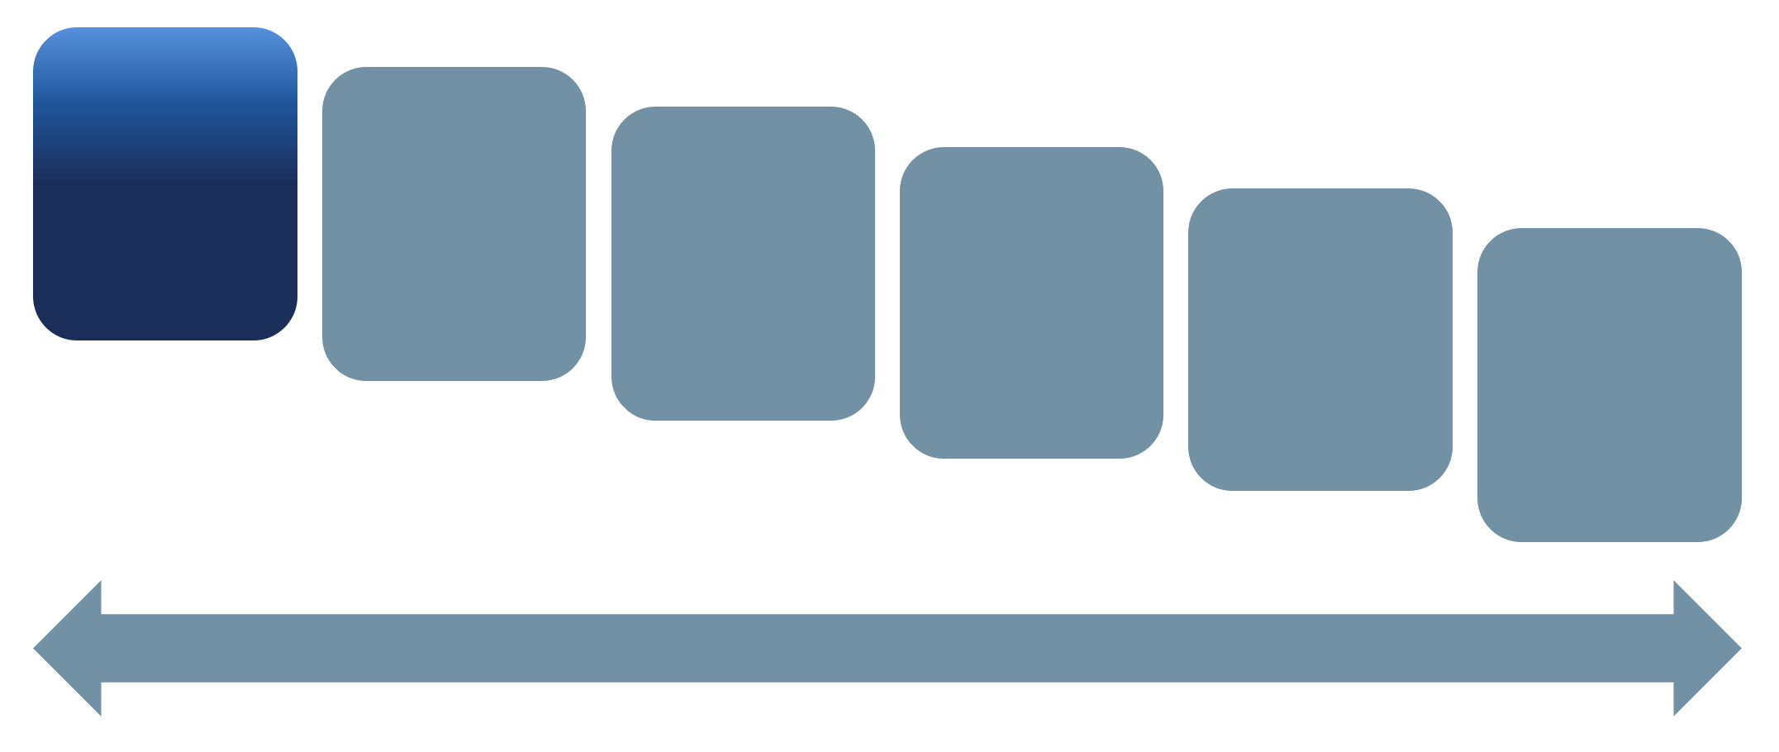
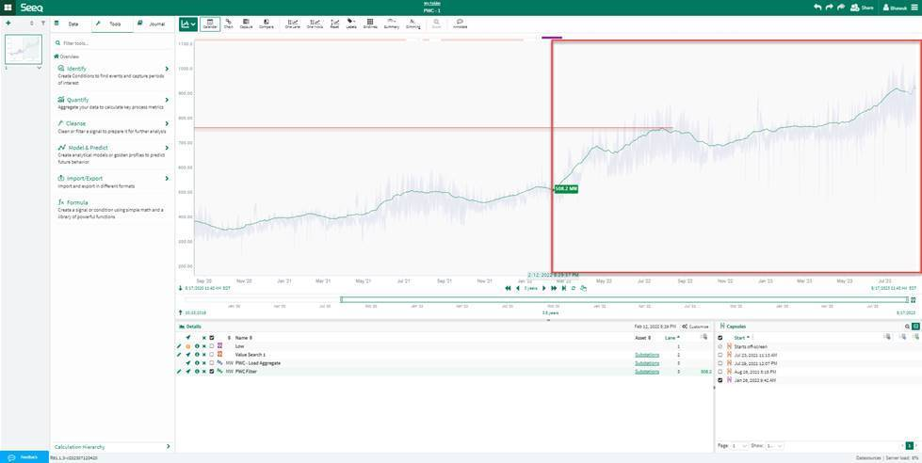
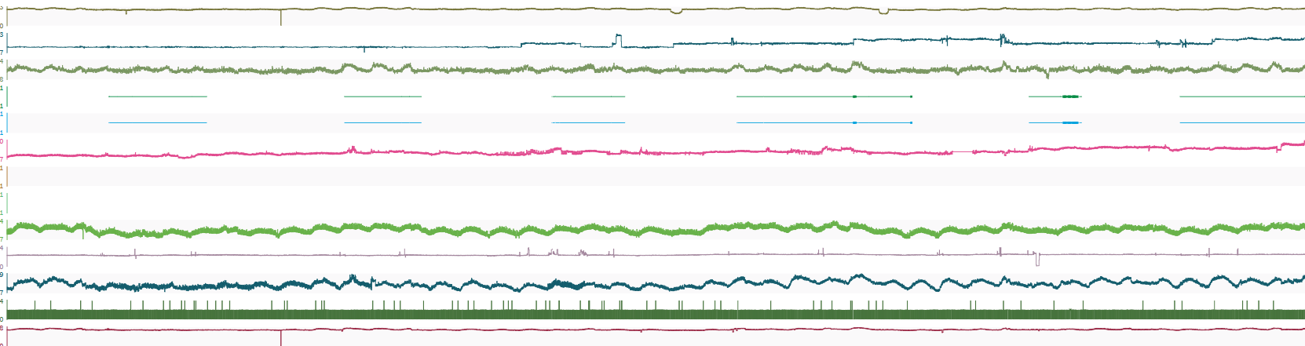
Data Collection & Processing
FRAMEWORK
Data Collection and Processing
Challenges & Solutions of Building an Evolving Hierarchy
Challenge: No listing of substations / transformers / delivery points.
Solution: Collaborated w/ other transmission teams (SOC & Planning) to develop a comprehensive list of assets in constrained area and build hierarchy in SeeQ.
Challenge: Limited historical data for delivery points and substations.
Solution: Built automated calculations in SeeQ to estimate missing data for delivery points, transformers, substations, and area-level load.
Notes:
One of the challenges we faced was different definition for operation, agreed upon definition of constrained zone.
The increase in the trend is growth but in reality, it could be missing data.

Slide 10

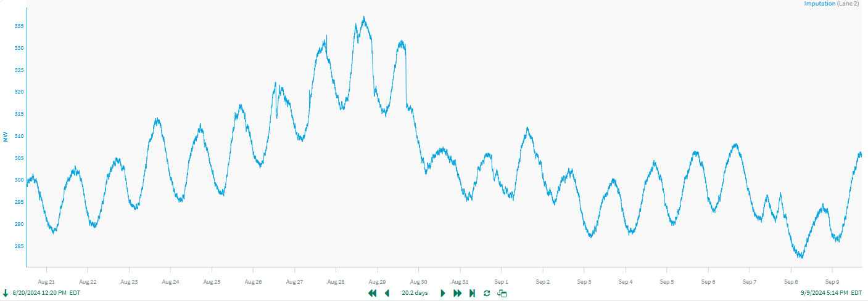
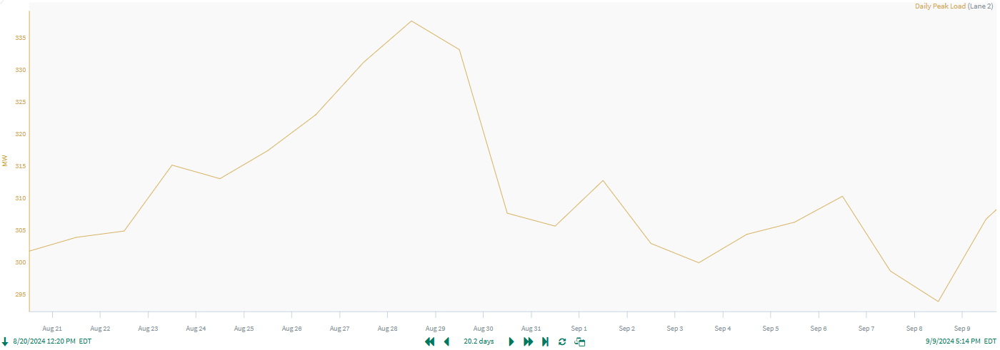
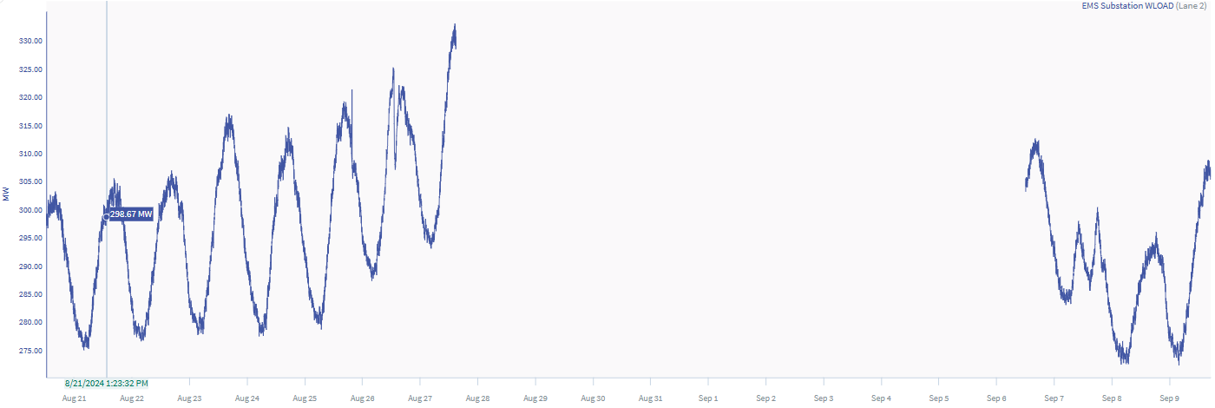
Enhancing Data Quality
FRAMEWORK
Exploratory Data Analysis
Aiming to avoid garbage in, garbage out
Visual Inspection
Data Imputation Techniques
Clean Data
Missing Data
Data Ready for Forecasting

Slide 11
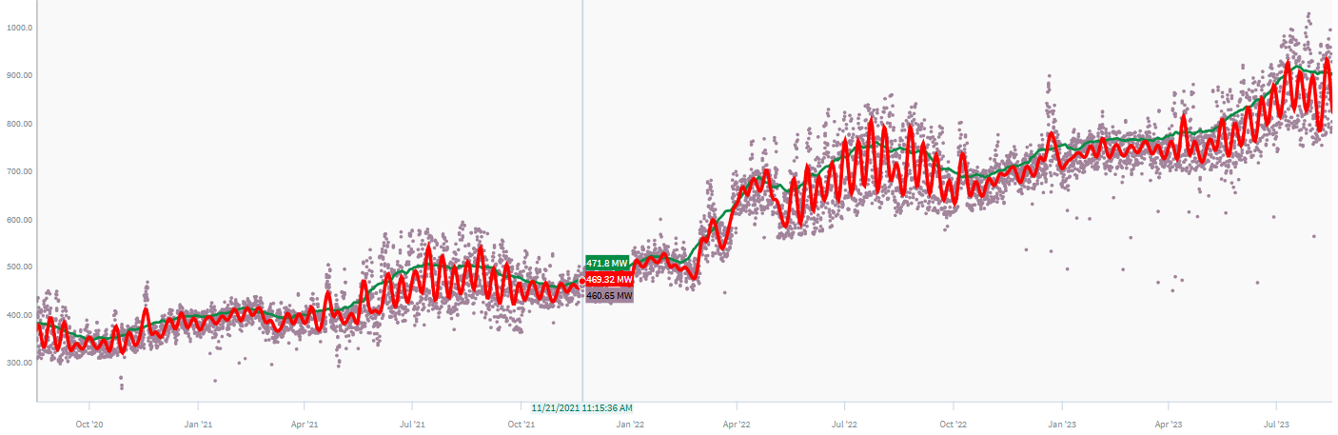
Filtering Techniques for Outlier Detection
FRAMEWORK
Exploratory Data Analysis
Identifying Best Techniques to Clean the data
Filtering Techniques:
Low pass Filter: Captures more Variance in the data
Moving Average: Smoothing the signal
Identify Outliers

Slide 12
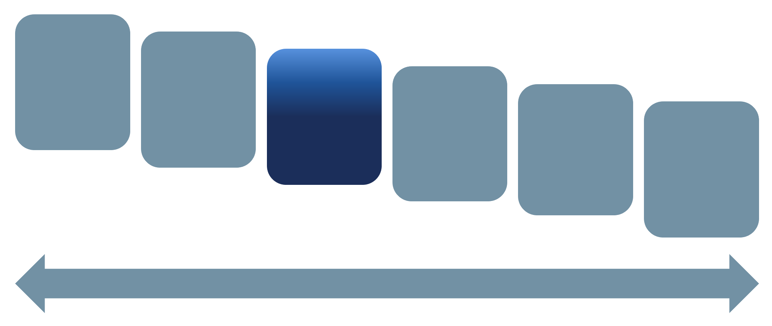
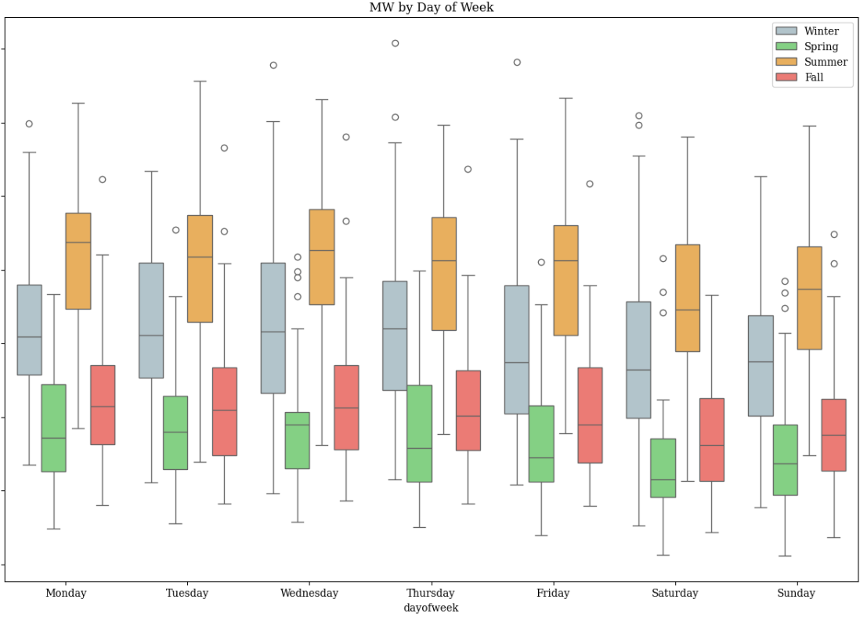
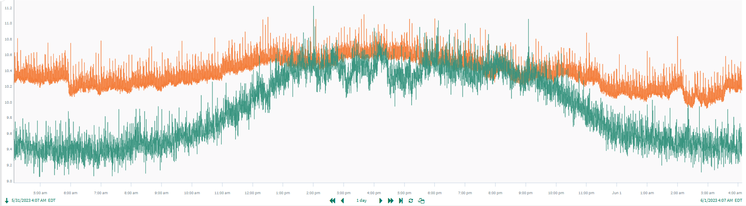
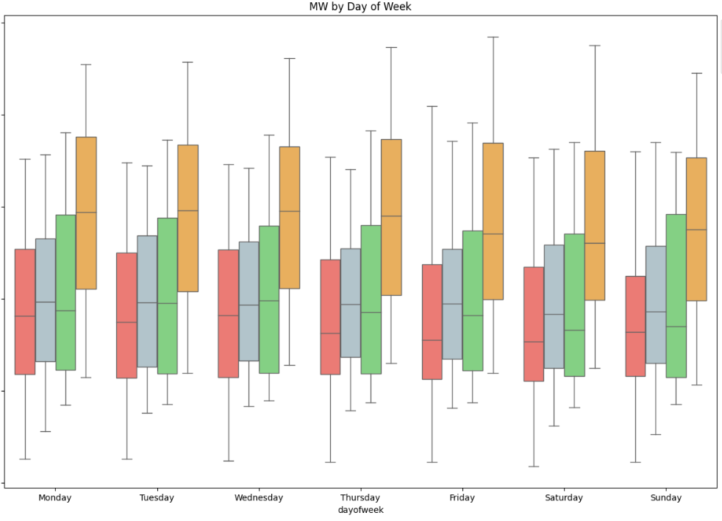

Pattern Recognition to Build Load Profiles
FRAMEWORK
Feature Engineering
Conforming vs Non-Conforming
Daily Seasonality
Weekly Seasonality
Residential Loads
Variable
Data Center Load Residential Load
Data Center Loads
Consistent

Slide 13
Enabling Dominion
Applied Forecast Case Studies

Slide 14
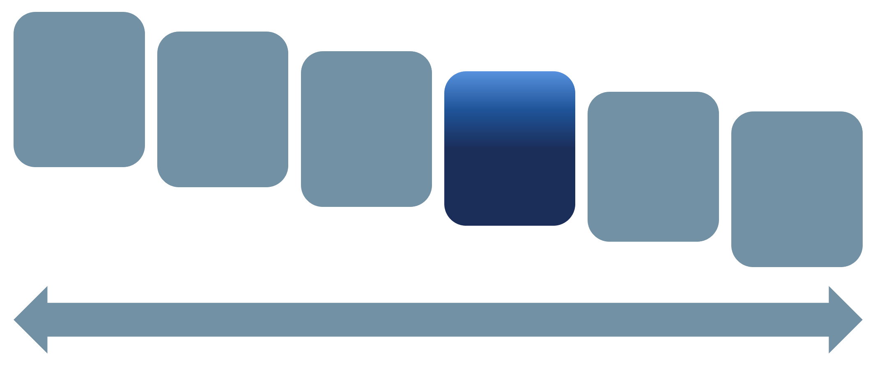
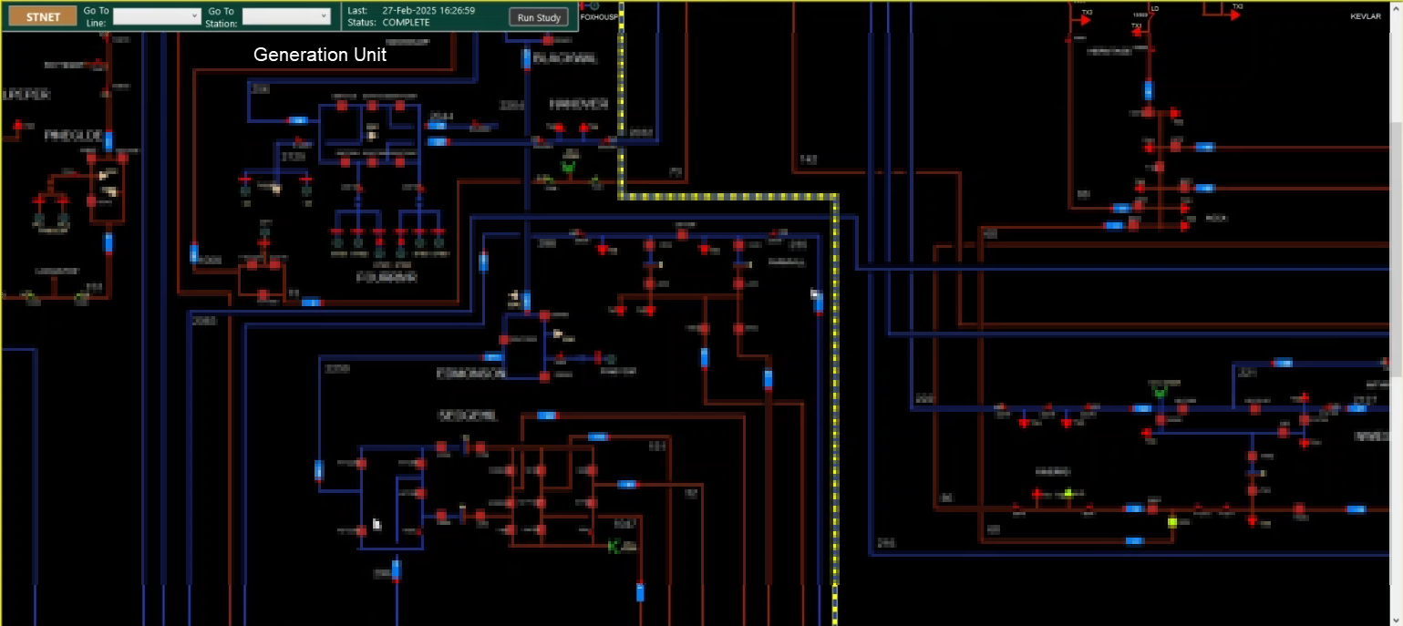
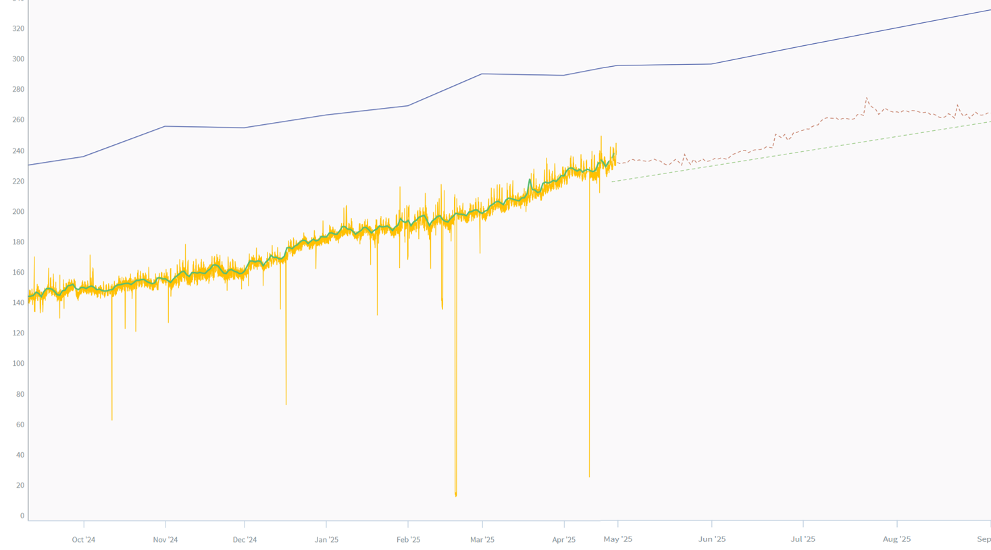
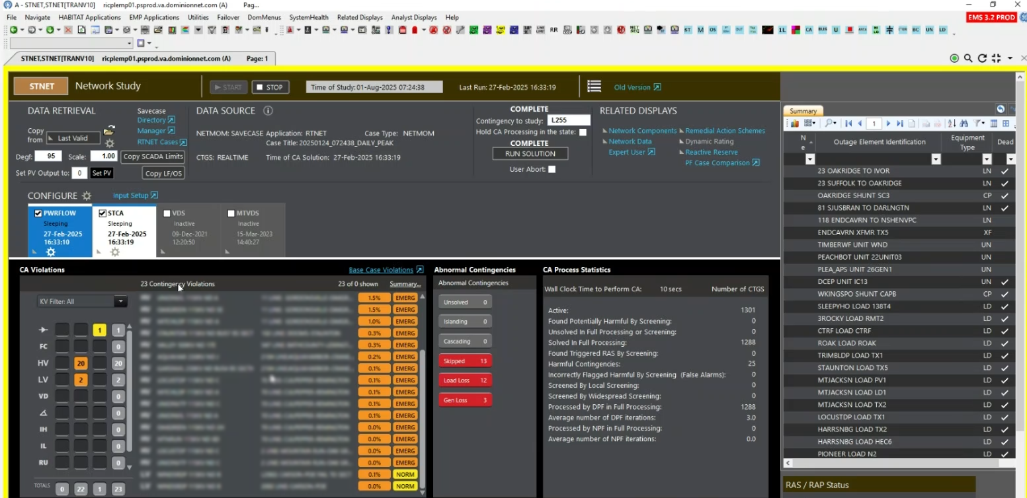
Scheduling Outages Intelligently with our RTO
CASE STUDY 1
Model Selection
Supporting SOC and PJM in planning and prioritizing outages
Challenges:
Unable to schedule outages as limited data was available to make decision.
Solution:
Integrated Load Ramp Rate
Analyze System to identify contingencies like thermal and voltage violations with bulk Load.
Studying the impact of solar and scheduling outages to meet the demand.
Load Ramp
SARIMA Forecast
Data for forecasting
LINEAR Forecast
Raw Data
Results:
Developed Load Forecast.
RTO approved planned outages after rescheduling it during summer months
Plan to add cap bank to support the load

Slide 15

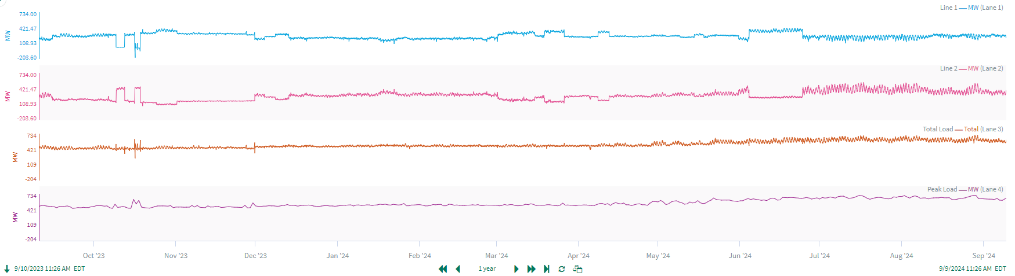

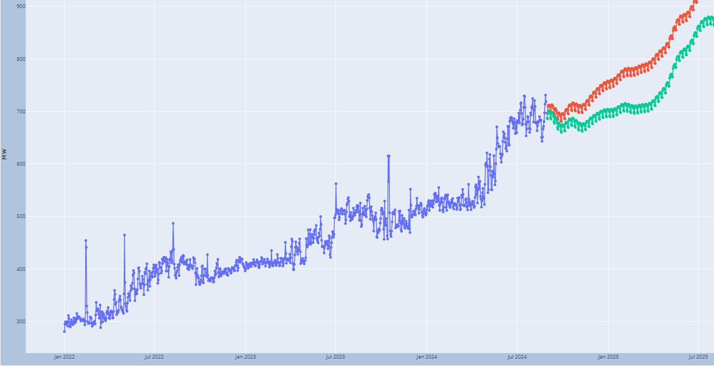
How our Forecast Enabled an SOC Decision
CASE STUDY 2
Develop Forecast
Building Forecast for System Maintenance
Challenge:
Identify unprecedented growth.
Solution:
Results:
Line Forecast: Aggressive and Conservative Forecast
Reprioritized Outages
Potential Load Shed
Aggressive
Conservative

Slide 16
Visualization
The Importance of Data Storytelling

Slide 17
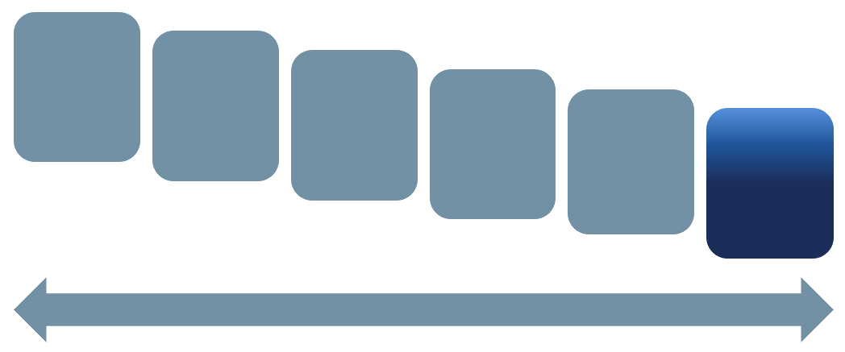
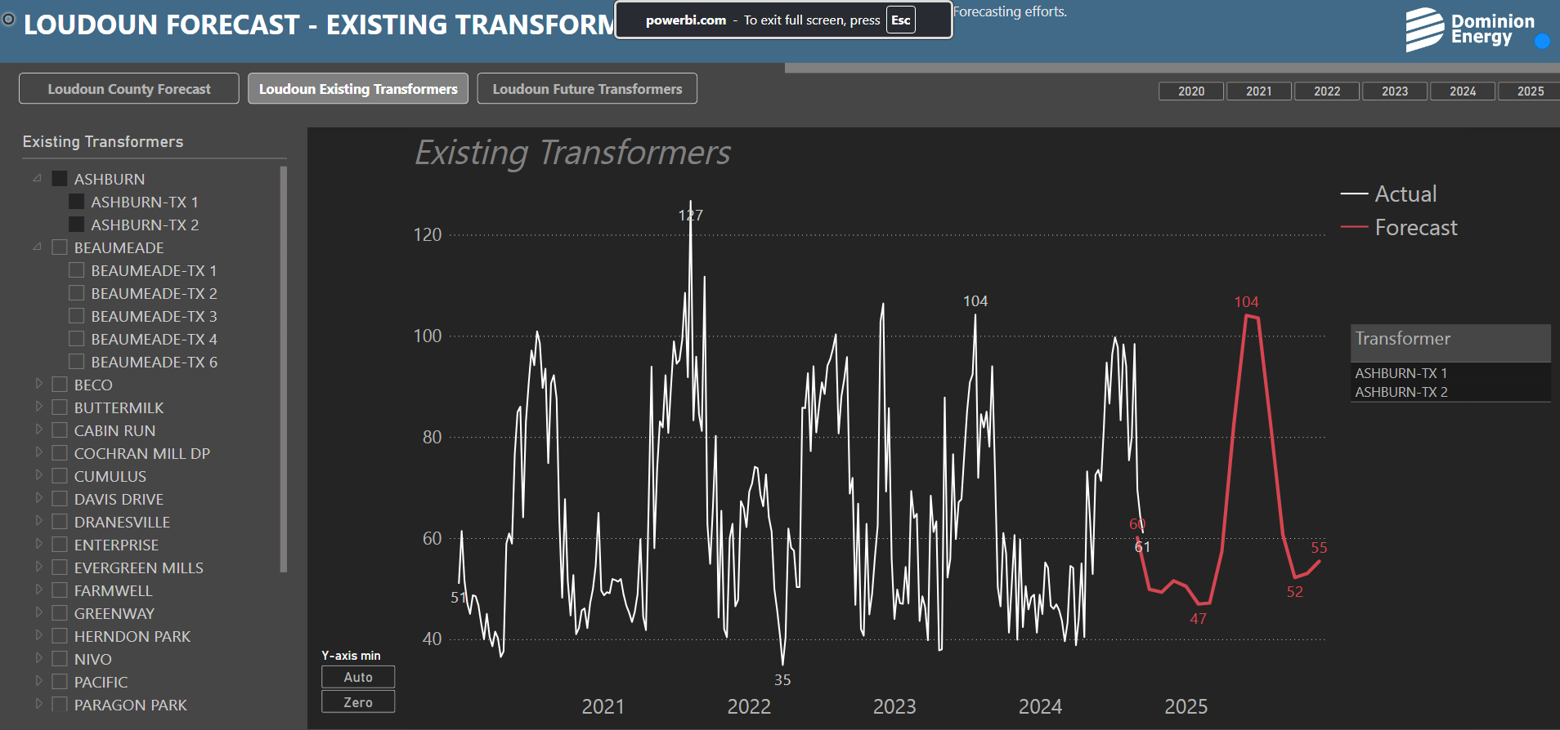
Making Forecasts Accessible
USING VISUALIZATION TO DRIVE DISCUSSION
Feedback
We’re serving our data in Power BI displays with intuitive navigation to drive thoughtful analysis
AREA 1
AREA 2
AREA 3
It was critical that our data product and data stories be accessible through enterprise tooling to reaching a broader audience that may benefit from the forecasts we produce quarterly.
SUBSTATION 1
TRANSFORMER-1
TRANSFORMER-2
SUBSTATION 2
TRANSFORMER-1
TRANSFORMER-2
TRANSFORMER-3
TRANSFORMER-4
TRANSFORMER-5
SUBSTATION 3
SUBSTATION 4
SUBSTATION 5
SUBSTATION 6
SUBSTATION 7
SUBSTATION 8
SUBSTATION 9
SUBSTATION 10
SUBSTATION 11
SUBSTATION 12
SUBSTATION 13
SUBSTATION 14
SUBSTATION 15
SUBSTATION 16
SUBSTATION 17
Notes:
Framing a story about Forecasting. Multiple Groups are doing forecasting and new tools are coming like Load Seer, different approaches
Which is good as It encourages open discussion about these different narratives.
10% increase in load in next 5 years
Stimulate discussion , steps towards decision working

Slide 18
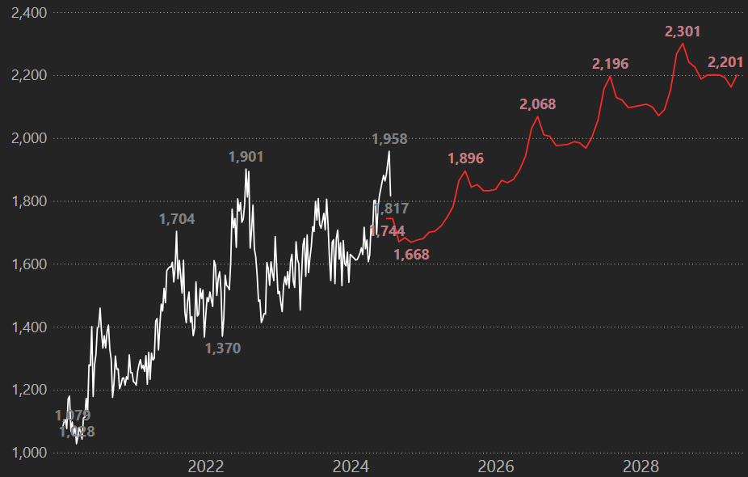
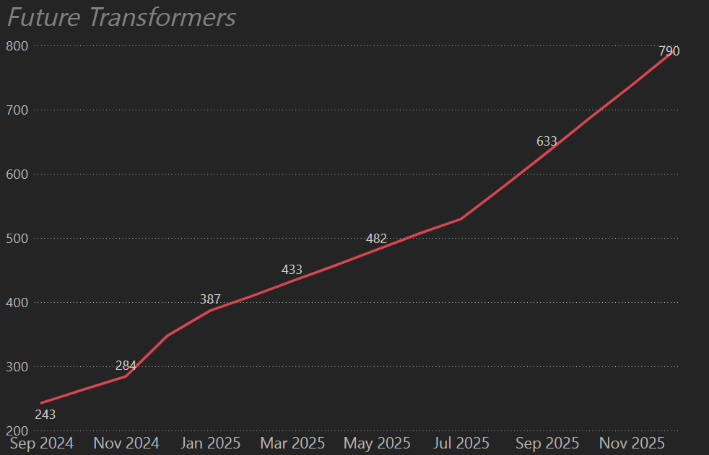
Visualizing Growth vs. Forecast
TRENDS FOR PAST AND FUTURE
Feedback
Showing decision-makers and engineers an evolving story of system growth
Actual vs Forecast
New Bulk Load
Forecast
Actual

Slide 19


Thank You
Questions? Get in touch!
Bhawuk Luthra
bhawuk.luthra@dominionenergy.com
Josh Mellen
joshua.m.mellen@dominionenergy.com

